Slide 1
Handling of Checkbox, Radio Button & Dropdown

Slide 2
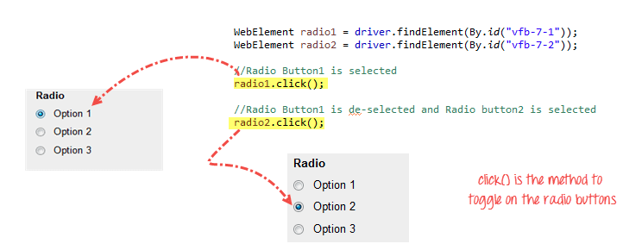
Radio Button
Radio Buttons can be toggled on by using the click() method

Slide 3
Check Box:
Toggling a check box on/off is also done using the click() method.
Example:
WebElement option1 = driver.findElement(By.id("vfb-6-0"));
// This will Toggle the Check box
option1.click();
// Check whether the Check box is toggled on
if (option1.isSelected()) {
System.out.println("Checkbox is Toggled On");
}

Slide 4
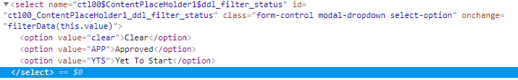
DropDown
To handle drop down and multi select list using Selenium WebDriver, we need to use Select class
The Select class is a Webdriver class which provides the implementation of the HTML SELECT tag.
Note: We can also use sendkeys to select dropdowns

Slide 5
Select Class
Steps:
1. Import the "Select" package.
Import org.openqa.selenium.support.ui.select
2. Declare the drop-down element as an instance of the Select class
WebElement dropDown= driver.findElement(By.name(“country”))
Select select=new Select(dropDown)
3. We can now start controlling "dropDown" by using any of the available Select methods
select.SelectByVisisibleText(“India”)

Slide 6
Select Methods
selectByVisibleText() Selects an option by its displayed text
deselectByVisibleText() Deselects an option by its displayed text
selectByValue() Selects an option by the value of its "value" attribute
deselectByValue() Deselects an option by the value of its "value" attribute
selectByIndex() Selects an option by its index
deselectByIndex() Deselects an option by its index
isMultiple() Returns TRUE if the drop-down element allows multiple selection at a time; FALSE if otherwise
deselectAll() Deselects all previously selected options

